Slide 1

Flying Into the Mind of Travellers A Data Story
Sadia Liaqat Ali
Data Analytics
DAB06

Slide 2







Root of this Analysis

Slide 3




Slide 4
About the data
Number of reviews = 23k
Number of Airlines = 497
Maximum Number of Reviews/Airline= 100
Minimum Number of Reviews = 1
Number of GCC Airlines = 6
Data collection period = 2004-2024

Slide 5

Analysis of Airlines Reviews from All Over the World
Brief Analysis on GCC Airlines Reviews
Gulf Air Reviews Analysis

Slide 6

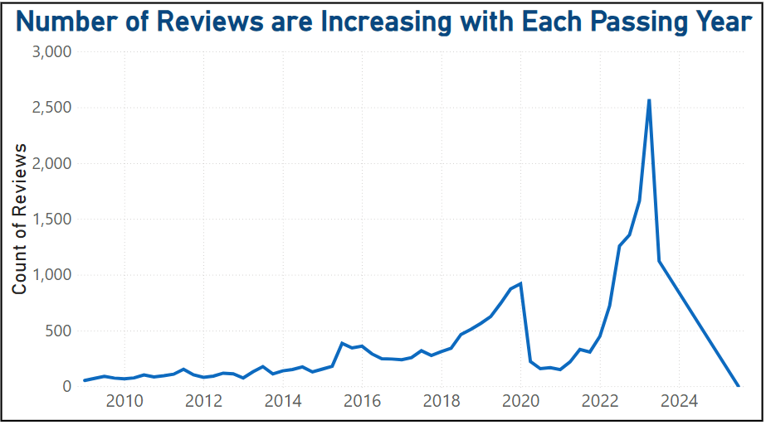

Slide 7
Overall Rating

Slide 8
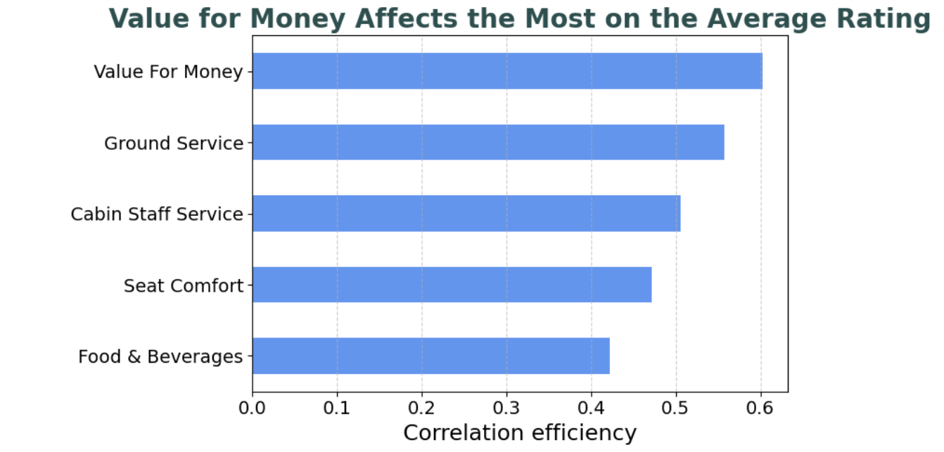

Slide 9

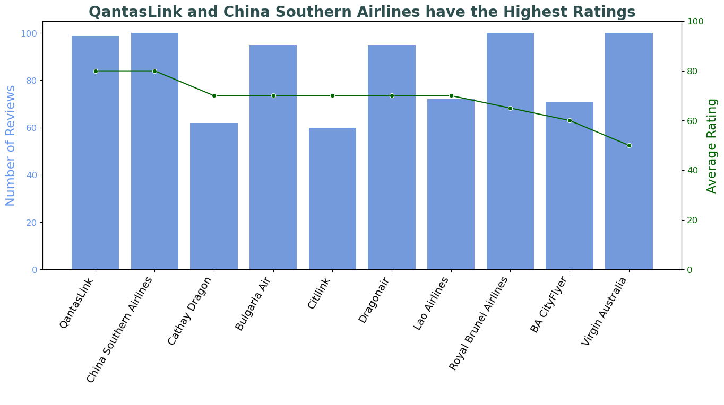

Slide 10
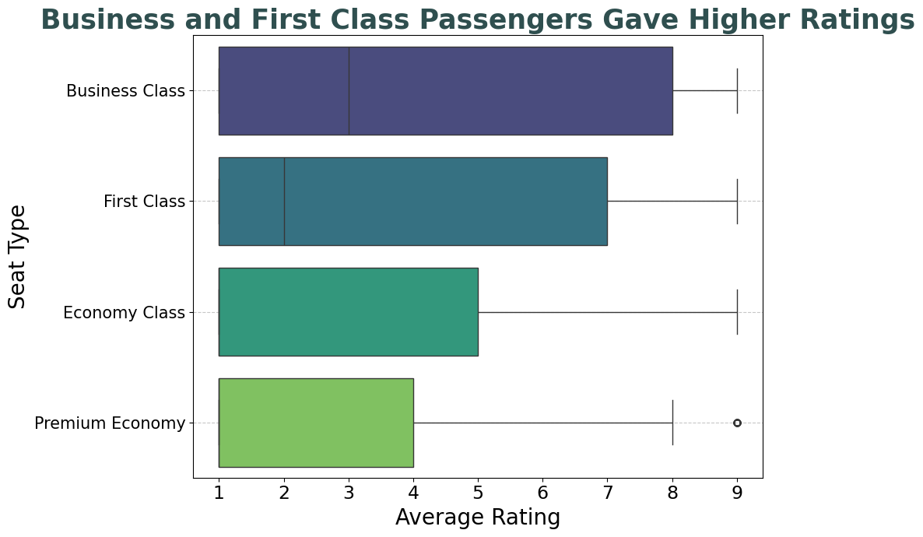

Slide 11
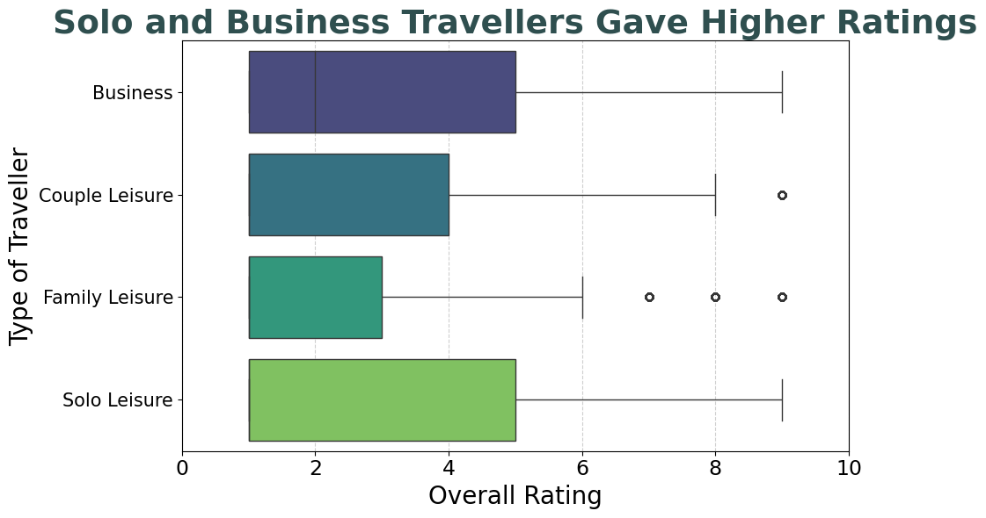

Slide 12
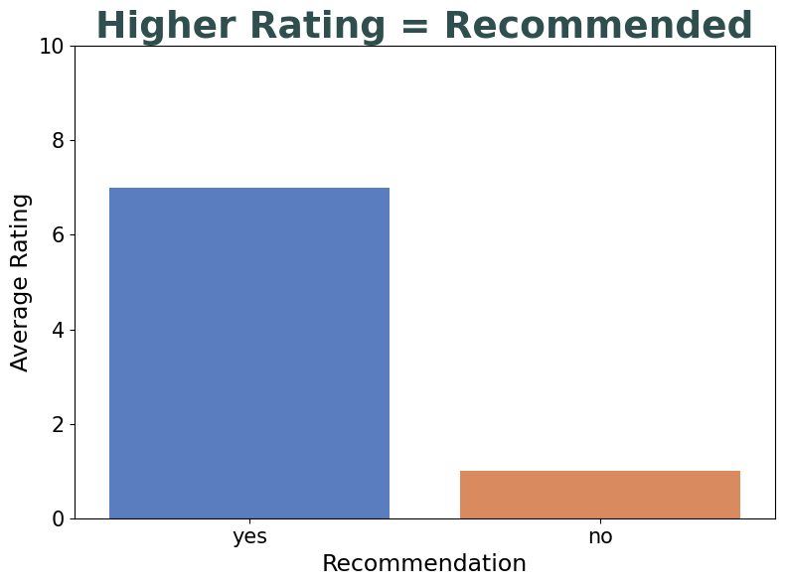


Slide 13
Written Reviews

Slide 14
Categorizing the Positive and Negative

Slide 15
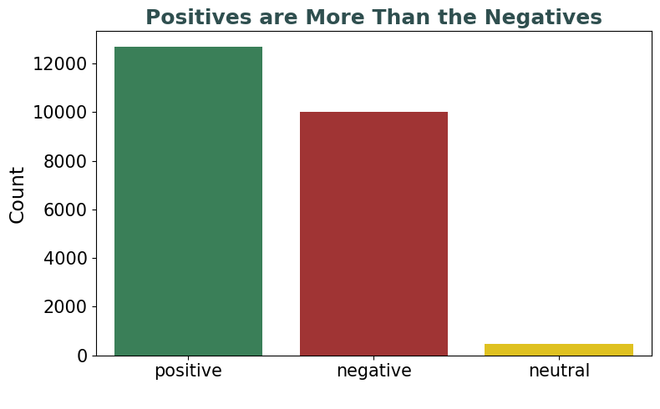

Slide 16
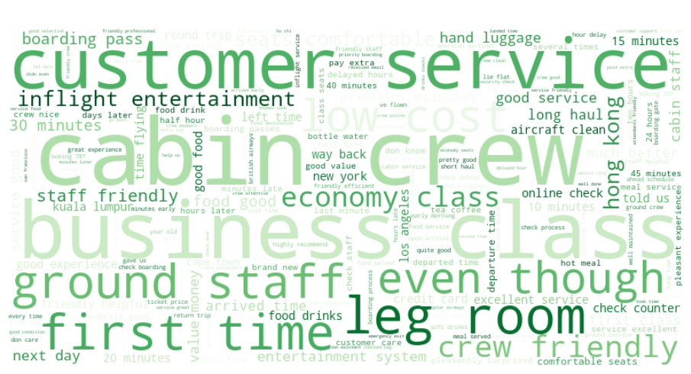

Slide 17
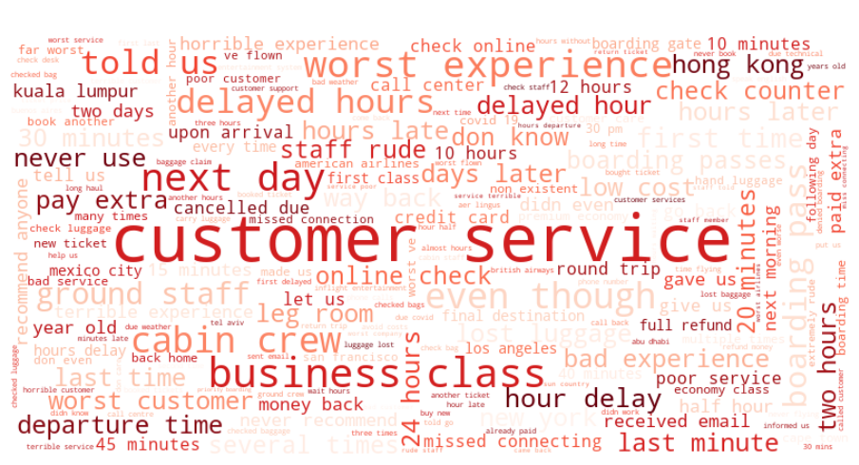

Slide 18
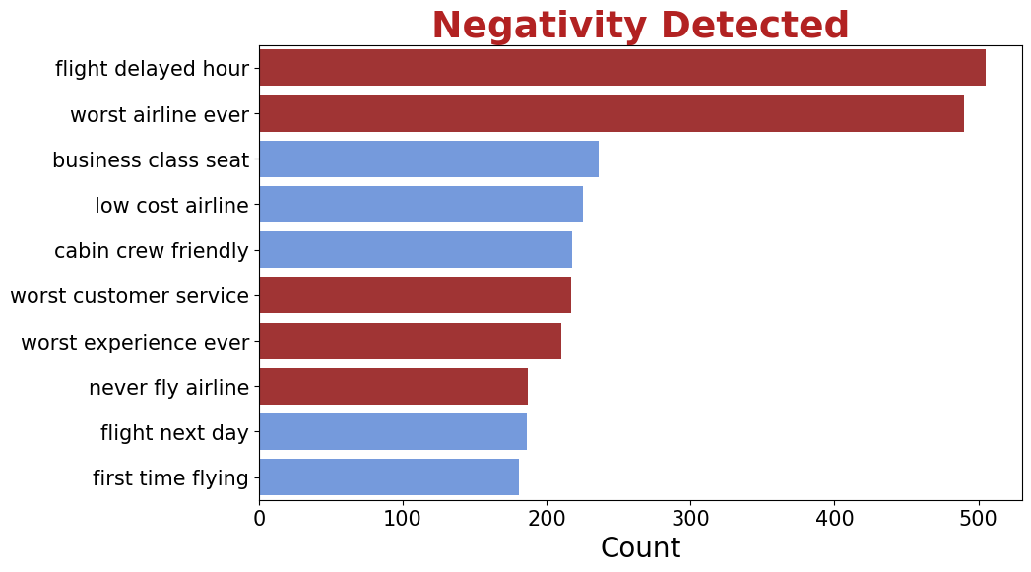

Slide 19
Classifying the Issues
Category | Count
Flight Delay/Cancellation | 6086
Baggage Issue | 1442
Customer Service Issue | 1073
Booking Problem | 912
Seat Comfort Issue | 199
Other/Uncategorized | 118
In-flight Service Issue | 60
Check-in/Boarding Issue | 48
App/Website Issue | 43
Refund/Payment Issue | 27

Slide 20
Getting into the heart of GCC Skies

Slide 21
Classifying the Issues in GCC Airlines
Category | Count
Flight Delay/Cancellation | 125
Customer Service Issue | 52
Baggage Issue | 47
Booking Problem | 35
In-flight Service Issue | 5
Seat Comfort Issue | 5
Other/Uncategorized | 2
App/Website Issue | 2
Check-in/Boarding Issue | 1

Slide 22
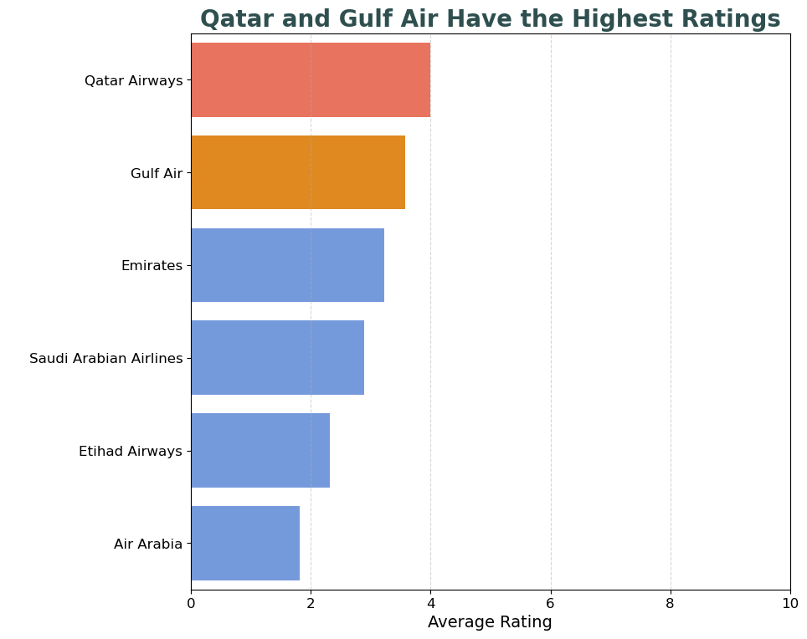

Slide 23
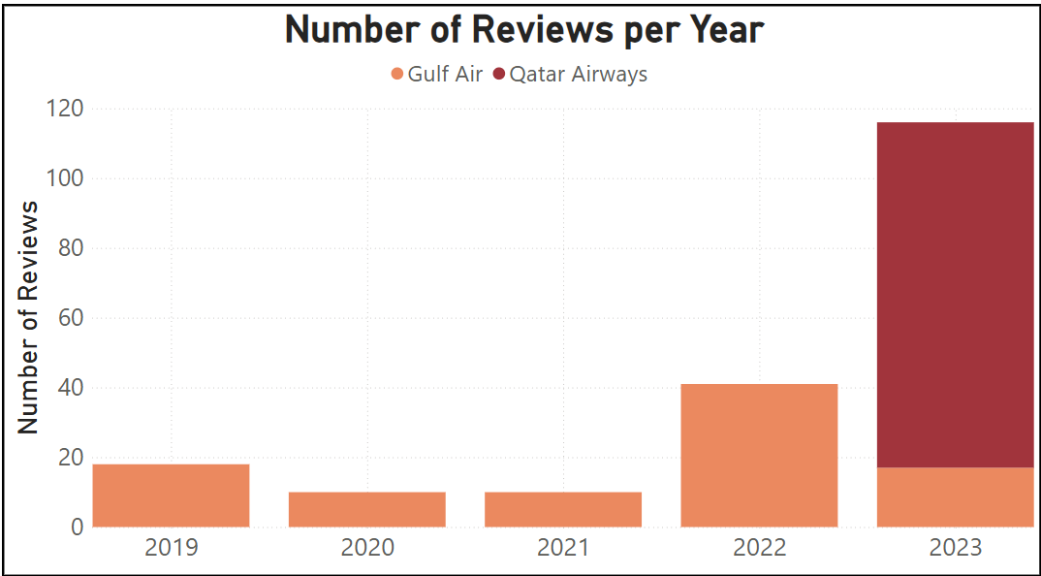

Slide 24
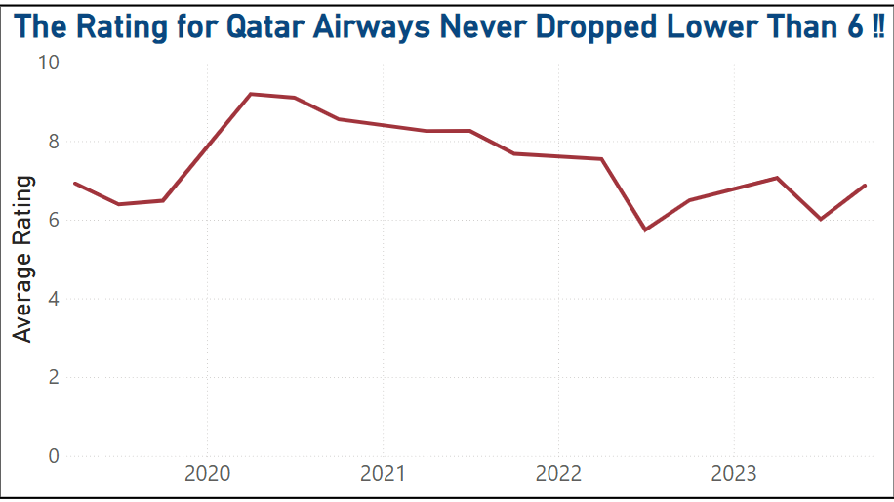

Slide 25
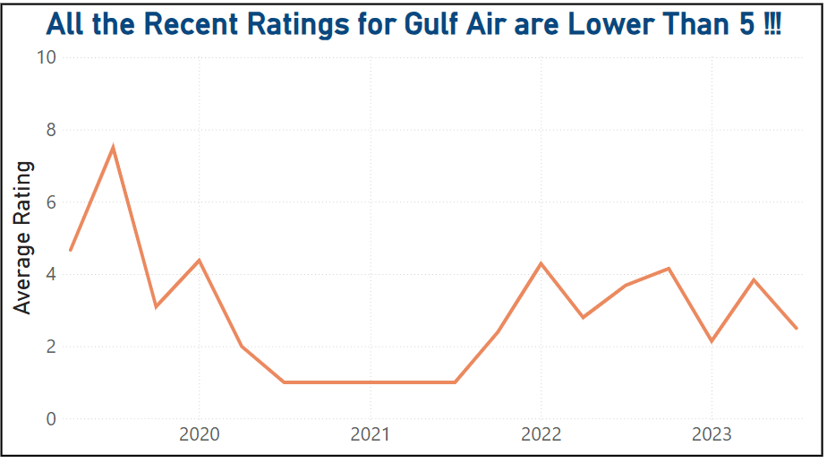

Slide 26
Spotlight On Gulf Air

Slide 27
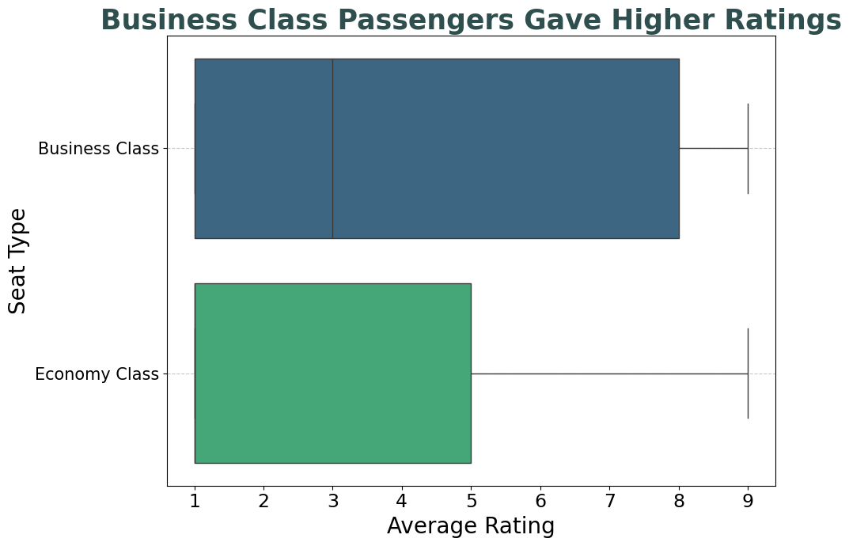

Slide 28
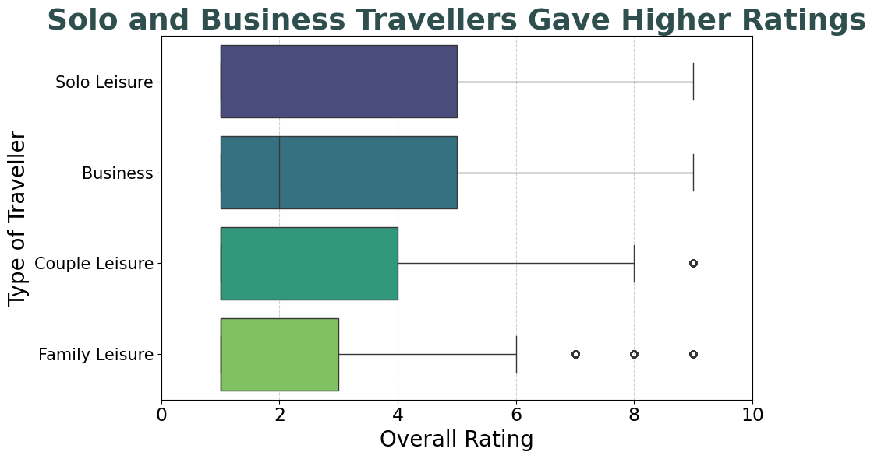

Slide 29
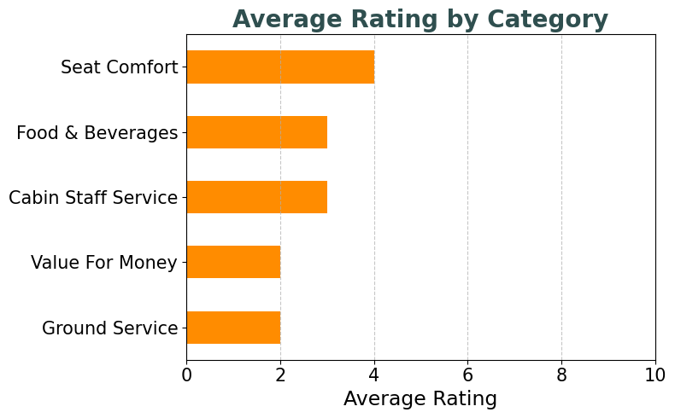

Slide 30
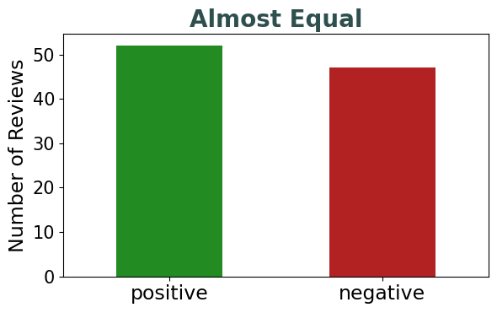

Slide 31
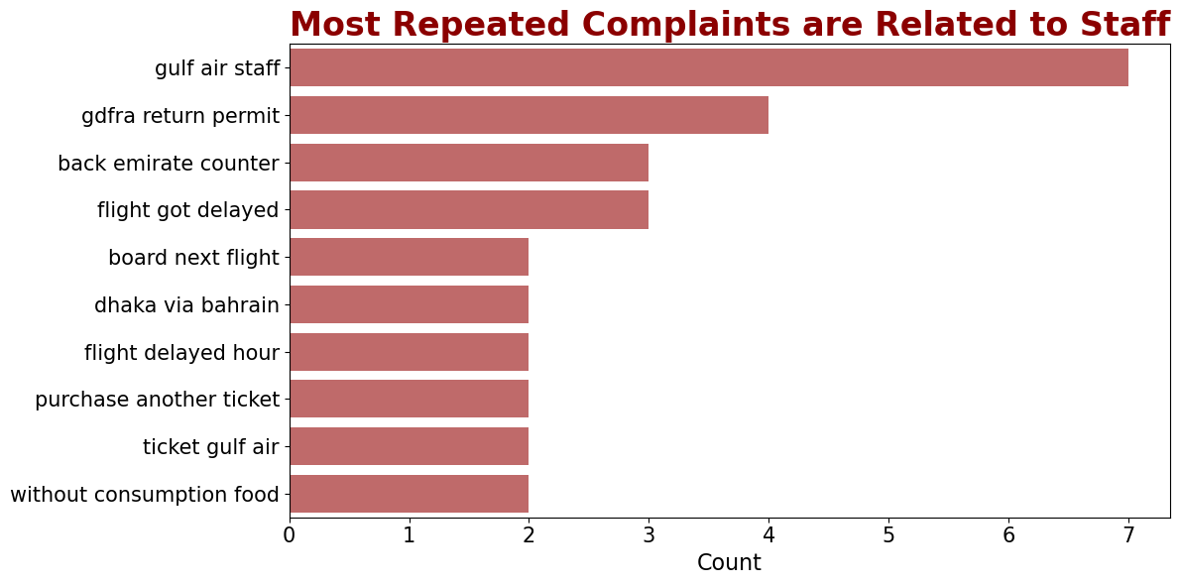

Slide 32
Categorizing the Problems
Category | Count
Flight Delay/Cancellation | 22
Customer Service Issue | 12
Booking Problem | 7
Baggage Issue | 4
Other/Uncategorized | 1

Slide 33
Underlying Reasons for Negative Reviews
Flight delays and cancellation.
Bad Customer Service.
Booking Issues.

Slide 34
Recommendations for Gulf Air
Be on time : People don’t like to wait to reach their destinations.
Focus on treatment : People don’t really remember how they are fed, rather how they are treated. Be kind, respectful, and fair.
Improve customer service : Train staff to be more patient and friendly.
Fix website issues : Make sure the booking system works smoothly.
Ask for feedback : Encourage passengers to fill out satisfaction surveys

Slide 35
Future Works
Utilize recent and up-to-date data.
More data for more comprehensive analysis.
Comparative analysis ( Gulf Air vs Qatar Airways).

Slide 36
ACKNOWLEDGEMENTS
I would like to thank all my instructors.
A huge thank you to my friends.
I would honestly like to thank CHATGPT.

Slide 37
Thank you!
Any Questions?

